Slide 1

Recommender Systems Workshop
Slideshow: https://bit.ly/3ji05zy
Notebook: https://bit.ly/3dzMDmM
Presented by Jack Douglas

Slide 2

Introduction
Jack Douglas
(he/him)
2B Software Engineering
Email: jack.douglas@uwaterloo.ca
LinkedIn: https://bit.ly/3gWuXUo
Notes:
Quick introduction

Slide 3
Workshop Overview
Intended Audience: Beginner to Intermediate Data Scientists
Goals:
Learn about what recommender systems do and the types of data that you will see in the real world
Learn about the three main types of recommender systems
Learn how to implement a recommender system on your own

Slide 4
Workshop Outline
What is a Recommender System?
Motivation
How Recommender Systems Work
Types of Data
Useful Notation
Approaches to Recommendations
Content-based Filtering
Collaborative Filtering
Hybrid Filtering
Movie Recommendations Notebook
Notes:
Go over the motivation and why you should care about this topic
So as you can tell from this outline, I’m going to be going over a lot of theory but we will also see the application of a recommender system in the notebook where we will show how to implement each of the approaches that we will discuss for a movie ratings dataset.
One thing to note is that you I would actually recommend that you not take notes unless you find that will really help your understanding. My goal for these slides are that you can make a copy of them and reference as notes. I think many of you will likely learn best by listening and being engaged. A lot of these first slides are fairly intuitive but are useful to understand when considering designing our recommender systems.

Slide 5
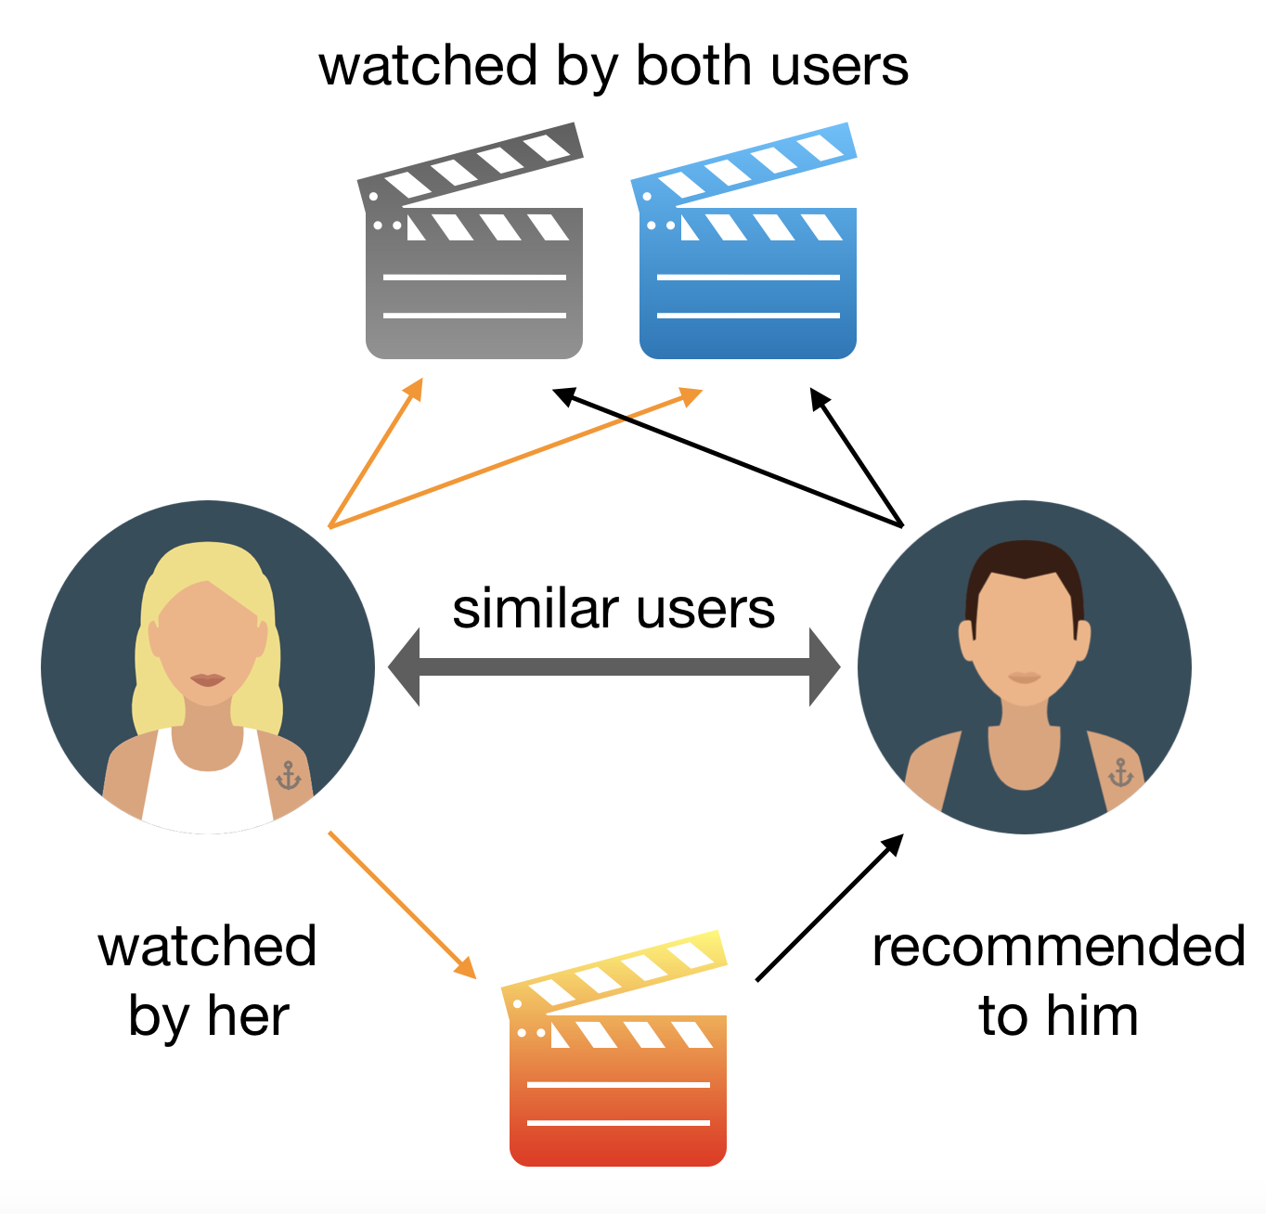
What is a Recommender System?
Def’n: a type of machine learning system that recommend new products and services to users
Recommender system looks at patterns of activities between different users and different products to produce these recommendations

Slide 6
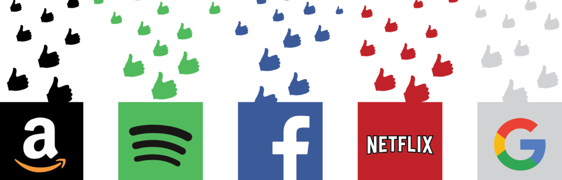
Motivation
Recommendation systems are used everywhere
Advertisements/product recommendations, song recommendations, and movie recommendations are some examples
Understanding recommender systems is a practical skill that can help make your résumé stand out!
Notes:
Some examples include:
Amazon products
Facebook, instagram, and google ads
YouTube videos
Song suggestions on Spotify
Movie recommendations on Netflix

Slide 7
How Recommender Systems Work
Recommender systems seek to understand 3 key relationships:
User - Product: based on users’ individual product preferences
Product - Product: based on similar products, either by appearance or description
User - User: based on similar users’ likely having similar product preferences
A combination of these relationships is used to sort the best recommendations for users
Notes:
I’m now gonna go over some examples of each relationship using movies. However, I want to mention that you can generalize these relationships to other things like food places, books, products, etc.

Slide 8
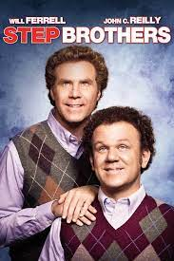


User - Product Example
If a user rates a movie highly, then the recommender system uses the connection between the user and genre, cast, director, etc. to create recommendations:
User A Profile
Likes comedy
Likes Will Ferrell
Likes John C. Reilly
etc.
User 1

Slide 9
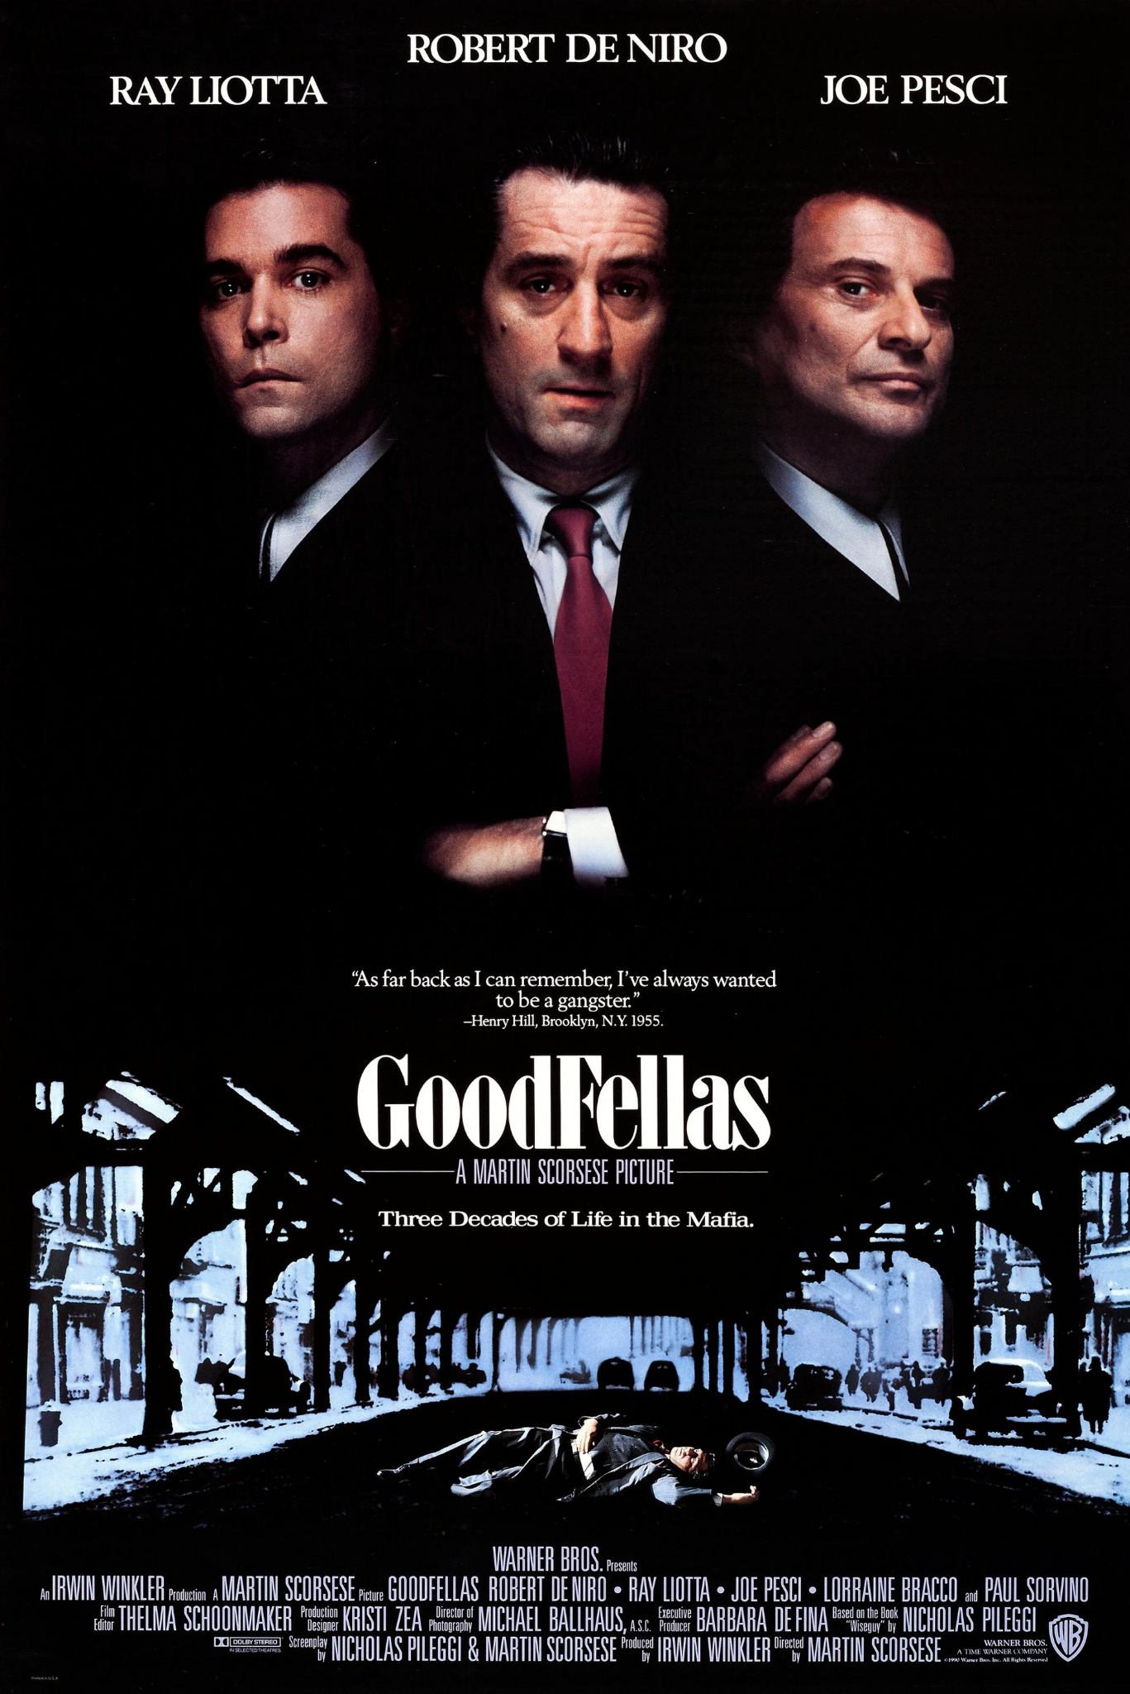

Product - Product Example
If two products share many attributes, then the recommender system forms a connection between the two products:
Similar casts, similar genres, same director

Slide 10

User - User Example
If a two users rates a movie highly, then the recommender system uses that connection between the two to help create recommendation:
User 1
User 2

Slide 11
Types of Data
Type 1: User behaviour data (needed in all recommender systems)
Explicit Ratings: ratings provided by the user
Ex. ratings, reviews, likes, following
Implicit Ratings: ratings provided from users interacting with a product
Ex. clicks, views, purchases
Type 2: User demographic data (used in some recommender systems)
Ex. age, location, education, income
Type 3: Product attributes (needed in content-based filtering)
Ex. genre, type of item, company producing item

Slide 12
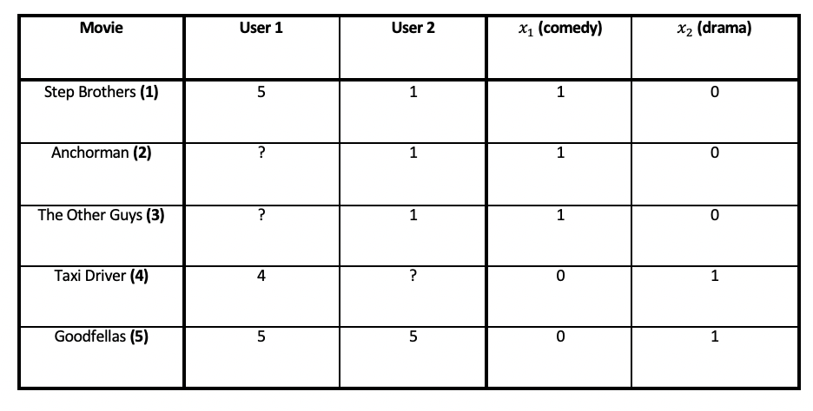
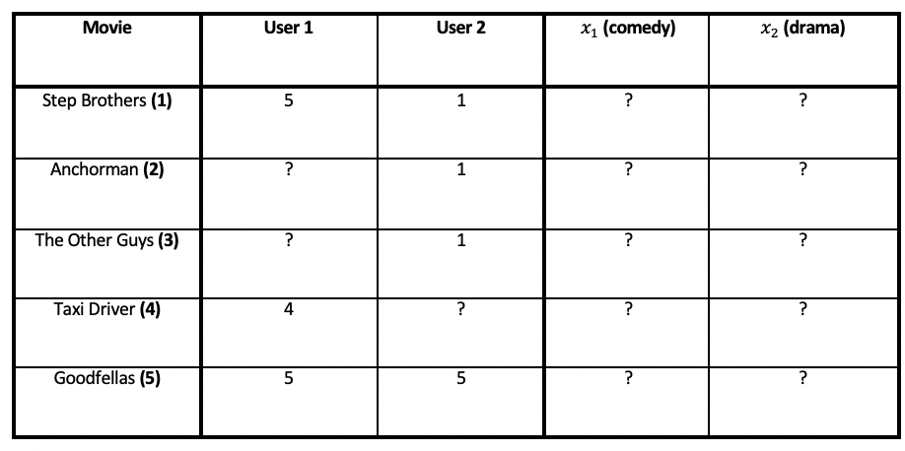
Movie Rating Dataset Examples
Dataset with product attributes
Dataset without product attributes

Slide 13
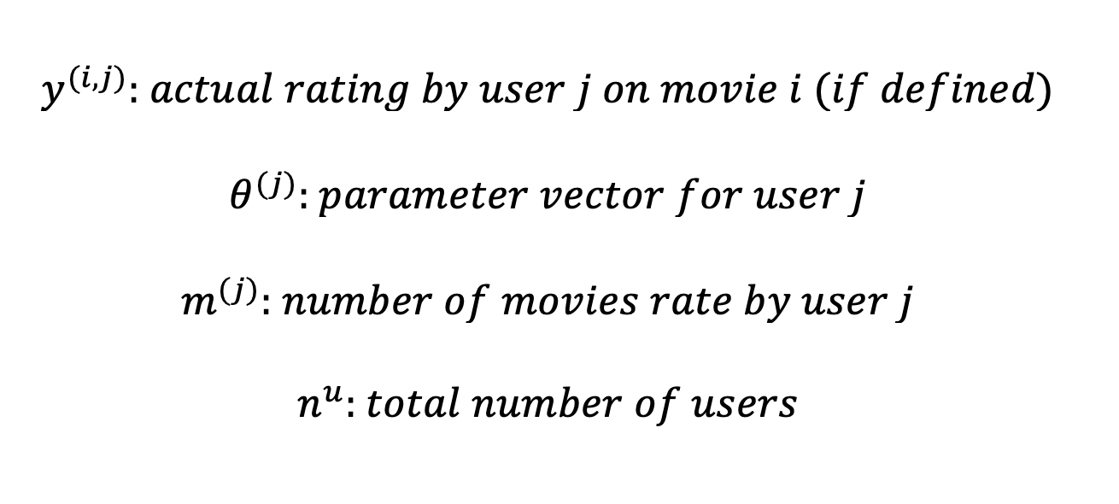
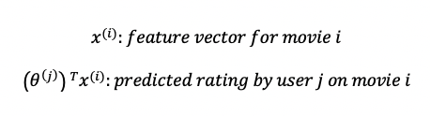
Useful Notation

Slide 14
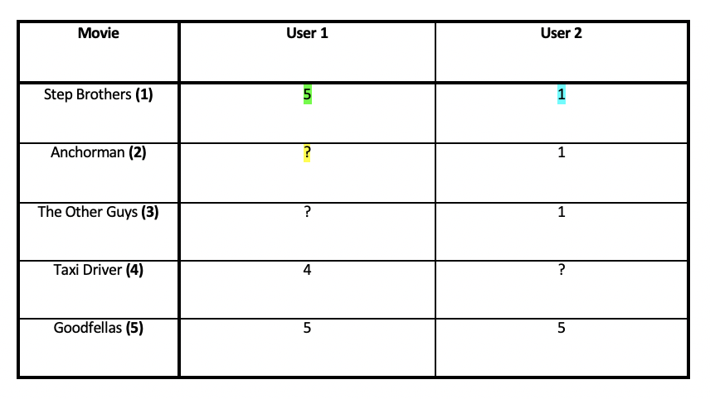
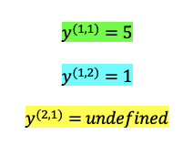
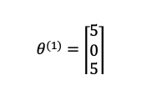
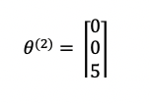
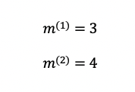
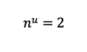
Notation Examples
Notes:
Note that in making our parameter vector for the users, we set the undefined values to 0

Slide 15
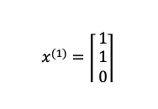
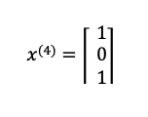
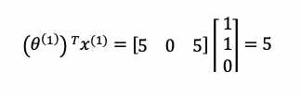
More Notation Examples

Slide 16

Approaches to Recommendations
Content-based: recommends products that are similar products to the ones that the user has liked in the past
Collaborative: recommends products that similar users have liked in the past
Hybrid: a combination of content-based and collaborative

Slide 17
Content-based Filtering
Content-based: recommends products that are similar products to the ones that the user has liked in the past
Using the User - Product and Product - Product relationships
Types of data used
Product attribute (necessary)
User behaviour (at least one “rating”)
How does it work: Predict the rating of each user with every movie as a regression problem!

Slide 18
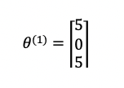
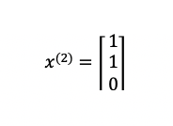
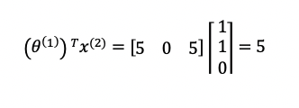
Content-based Filtering Optimization

Slide 19
Collaborative Filtering
Collaborative: recommends products that similar users have liked in the past
Using the User - Product and User - User relationships
Types of data used
User behaviour (need many “ratings”)
How does it work: Randomly create feature vectors, then make a prediction and adjust the feature vectors to move towards actual prediction

Slide 20
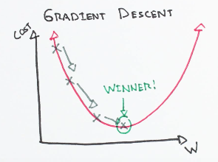
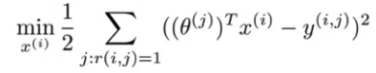
Collaborative Filtering Optimization

Slide 21
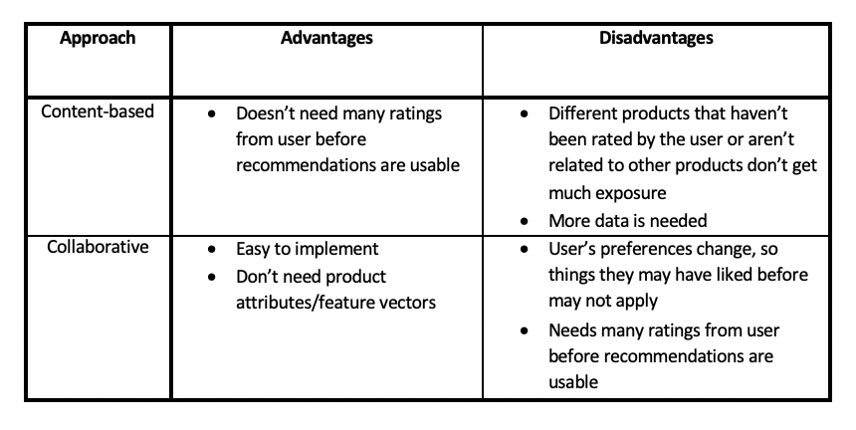
Advantages & Disadvantages

Slide 22
Movie Recommendation Notebook

Slide 23
Resources
An In-Depth Guide to How Recommender Systems Work: https://builtin.com/data-science/recommender-systems
Machine Learning by Andrew Ng: https://www.coursera.org/learn/machine-learning/home/welcome
Movie Recommender Systems by Memphis Meng: https://towardsdatascience.com/movie-recommendation-system-based-on-movielens-ef0df580cd0e
UWaterloo Data Science Channel: https://www.youtube.com/channel/UCknY88pglf2xz_S72WHIDxg

